Slide 1
Group 27
IS 436 Section 02- Structured Systems Analysis and Design
Deliverable 4
Bryan Baek
Brendan Bessel
Kalabe Mulugeta
Josiah Tillett
Xinbo Yang

Slide 2
About Aviation Port Service

Slide 3
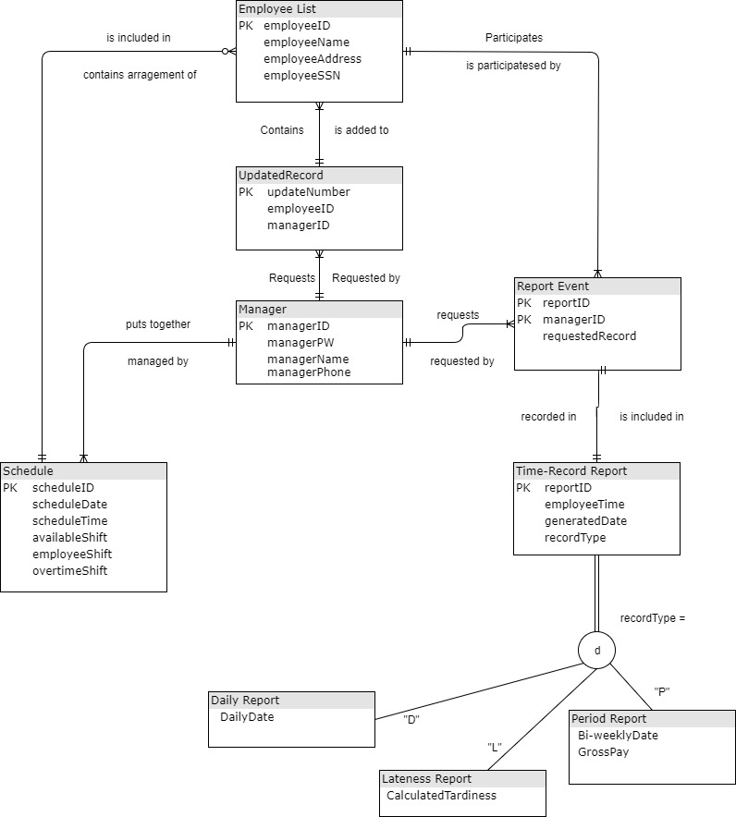
Entity Relation Diagram (ERD)

Slide 4
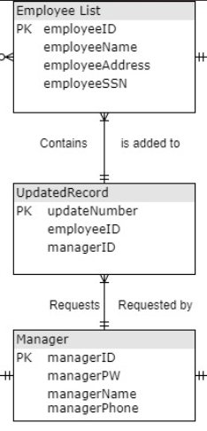
Entity Relation Diagram (ERD)

Slide 5
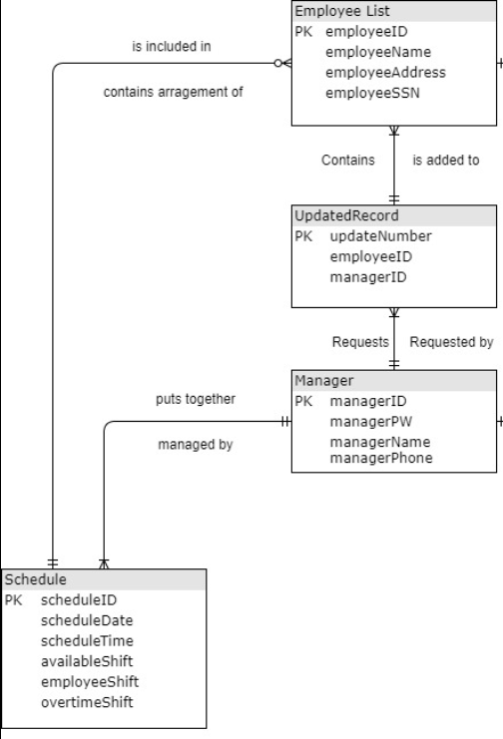
Entity Relation Diagram (ERD)

Slide 6
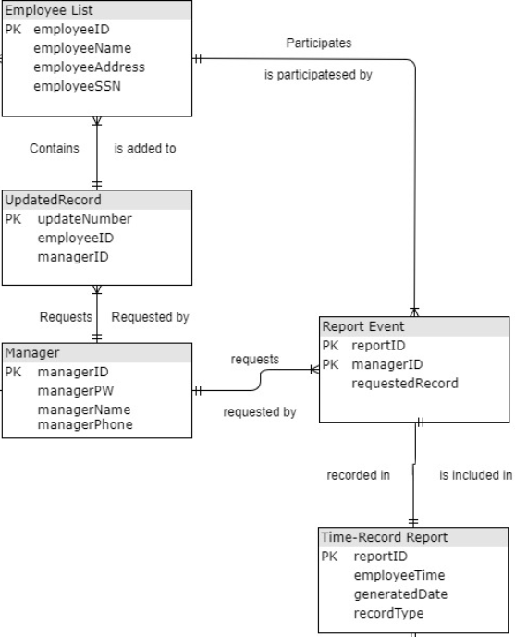
Entity Relation Diagram (ERD)

Slide 7
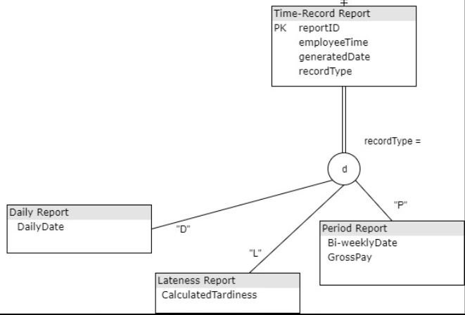
Entity Relation Diagram (ERD)

Slide 8
Alternative Matrix three alternatives
Alternative 1: Contracted Custom Application Using Linux, Apache, MySQL, PHP
This alternative utilizes an external programmer to build a custom designed solution for our system. The price is unclear because of the time needed to complete the project.
Alternative 2 - Packaged Software: Tsheets
This alternative is a packaged, licensed software. There are different editions available but for the needs of our company the basic package should be enough.
Alternative 3 - Packaged Software: Clock Shark
This alternative is a packaged, licensed software. There are different editions available but for the needs of our company the basic package should be enough. This is more or less the same as the previous packaged software option but with more features and a higher price point.

Slide 9
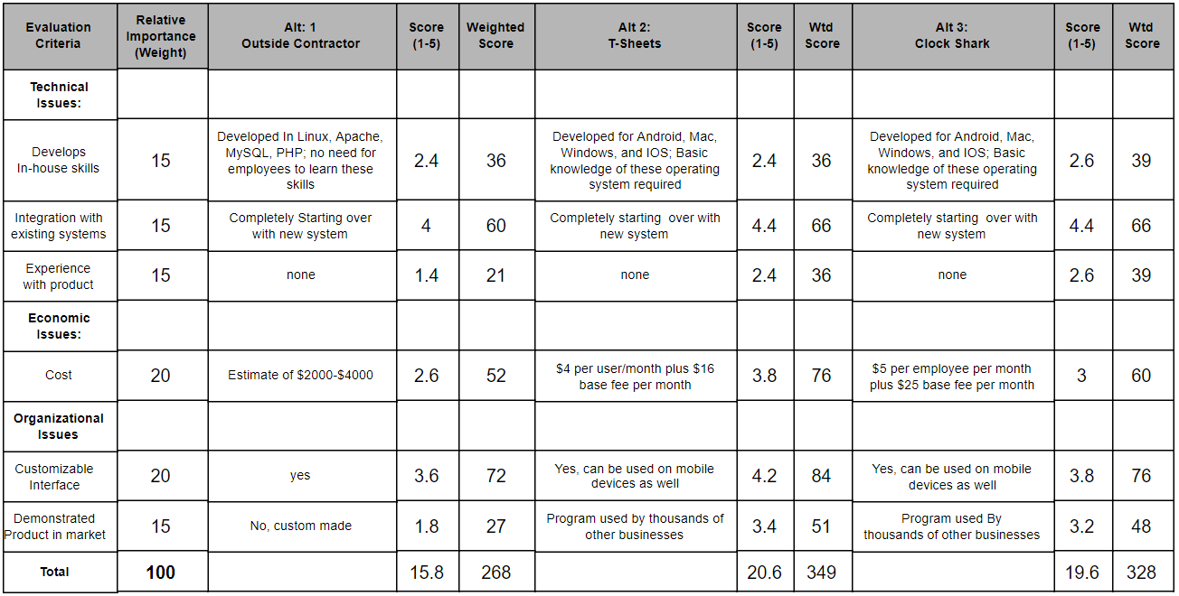
Team Matrix

Slide 10
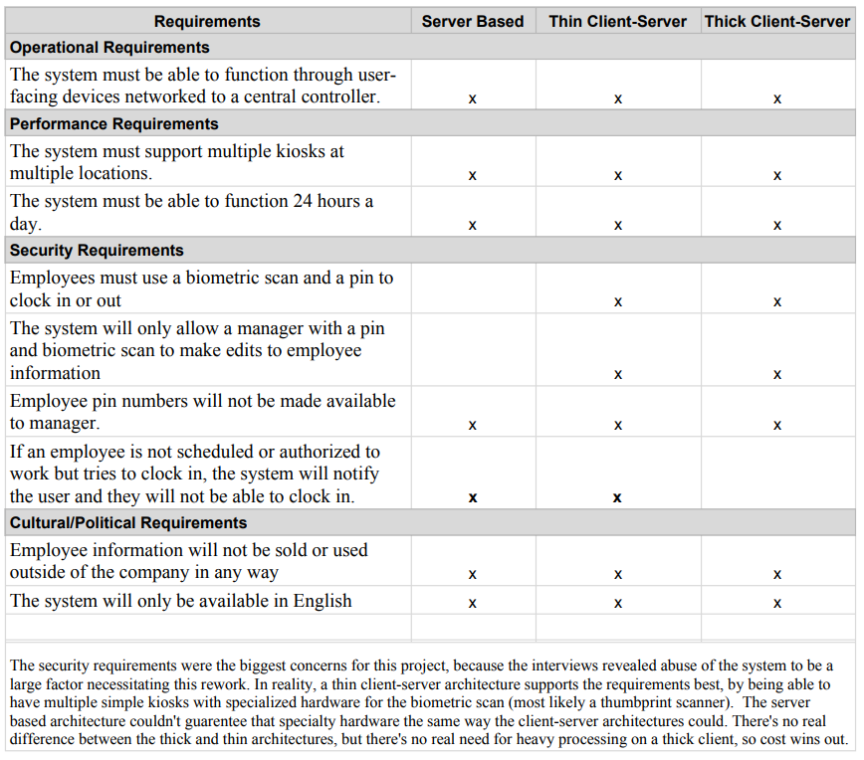
Architecture Matrix

Slide 11
Architecture Matrix

Slide 12
Architecture Matrix

Slide 13
Questions?

